Slide 1


Week 5: MAPIE and Creating a GitHub Repo
Building Interpretable AI in Healthcare
Michigan Data Science Team - Winter 2026

Slide 2
Week 5 Agenda
Icebreaker!
01.
02.
Conformal Predictions
03.
Git and GitHub
04.
Hands-On Data Science!
Every great project work session starts off with a great icebreaker.
How can we investigate the level of confidence our model has in the output it gives?
What is version control, why is it important, and how can one set up a repository?
Let’s use what we’ve learned to quantify the uncertainty in the models that we have trained!

Slide 3
01
Fun Icebreaker!!
Get to know us and start to learn about each other with a fun icebreaker!

Slide 4






Icebreaker - Week 5
Share with the people around you!! :)
What is your favorite Olympic sport to watch? (Or, what is your favorite sport?)

Slide 5
02
Conformal Predictions
How can we investigate the level of confidence our model has in the output it gives?

Slide 6
What are Conformal Predictions?
Conformal Prediction generates an interval with guaranteed coverage of a true but unknown parameter of interest.
Typically, this is done at the (1 - ɑ) level, where ɑ is the statistical threshold of confidence desired, generally between 0.1 and 0.01.
Instead of just a point prediction (“This is an apple”), gives a confidence interval (“Our model is 95% confident that this is an apple or a peach.”)
Assumes that observations are i.i.d. (independent and identically distributed), meaning that their order is exchangeable (does not matter)

Slide 7
Why are Conformal Predictions Useful?
Provides strict guarantees on error rates, even for small datasets
The interval you are given will certainly contain the true parameter at least (1- ɑ) percent of the time
Does NOT assume that the data follow any particular distribution. It also works for both regression and classification tasks.
If we get a rather wide interval for our prediction, we know that our model isn’t overly sure about which group a certain observation belongs to (in a classification context)

Slide 8
What are the Steps of Conformal Predictions?
1. Train: Split the dataset into a train-calibrate-test split, also, establish your level of confidence you with to achieve (typically between 90% and 99%)
2. Calibrate: Like Week 4, we utilize probability calibration to make sure that the prevalence of the categories in the model truly reflect their prevalence in the real world.
3. Predict: Use your X_test set to make both point predictions (“This is an apple”) and prediction sets (“95% confidence that this is an apple or a peach”)

Slide 9
03
Git and GitHub
What is version control, why is it important, and how can one set up a repository?

Slide 10
What is Git?
Git is a free, open-source distributed version control system (DVCS)
Used to track changes in source code during the software development process, particularly when working in large groups or as part of a larger team.
Distributed means that each developer that has access to a certain Git repository has access to the entire history of the program development on their local device.
Works as something as a time machine, with branches being isolated lines of development (typically just “origin/main”)
Merging combines these branches into one, using push and pull

Slide 11
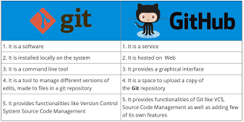

What is GitHub?
GitHub is a hosting service that affords a navigable interface for Git users to access and download version-controlled software.
Cloud-based server to host Git content
Very easy way to track issues, view others’ code, and work together with other developers to all work on the same project

Slide 12
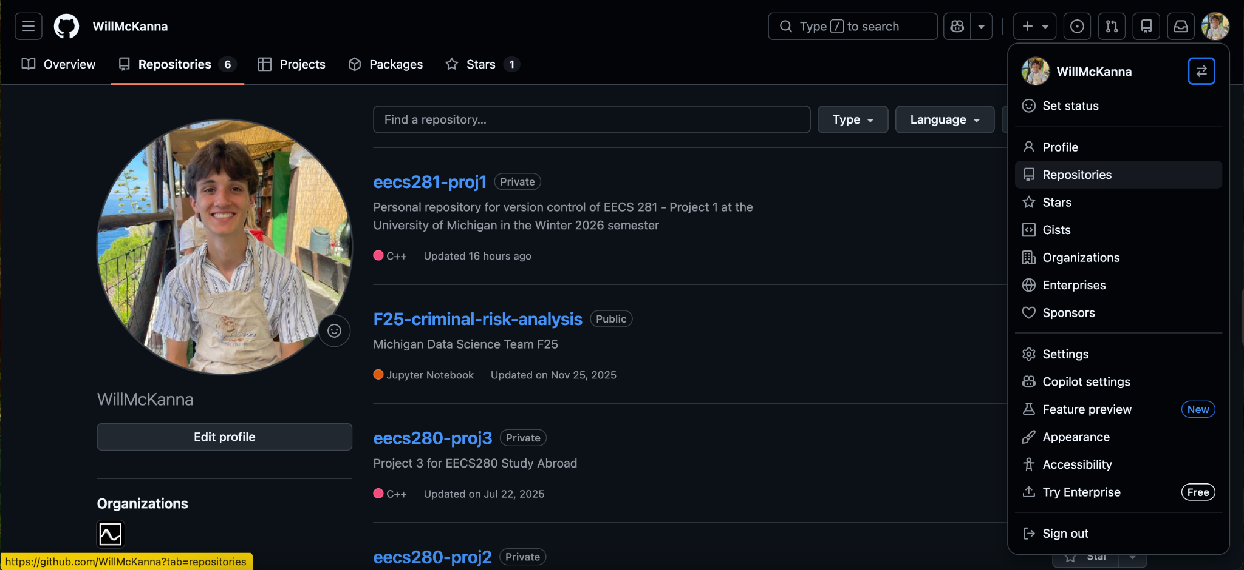
How to Create a GitHub Repository (yay for version control!)
Navigate to GitHub, click your profile picture, and select “Repositories.” Then, click the green “New” button next to the “Language” dropdown menu

Slide 13
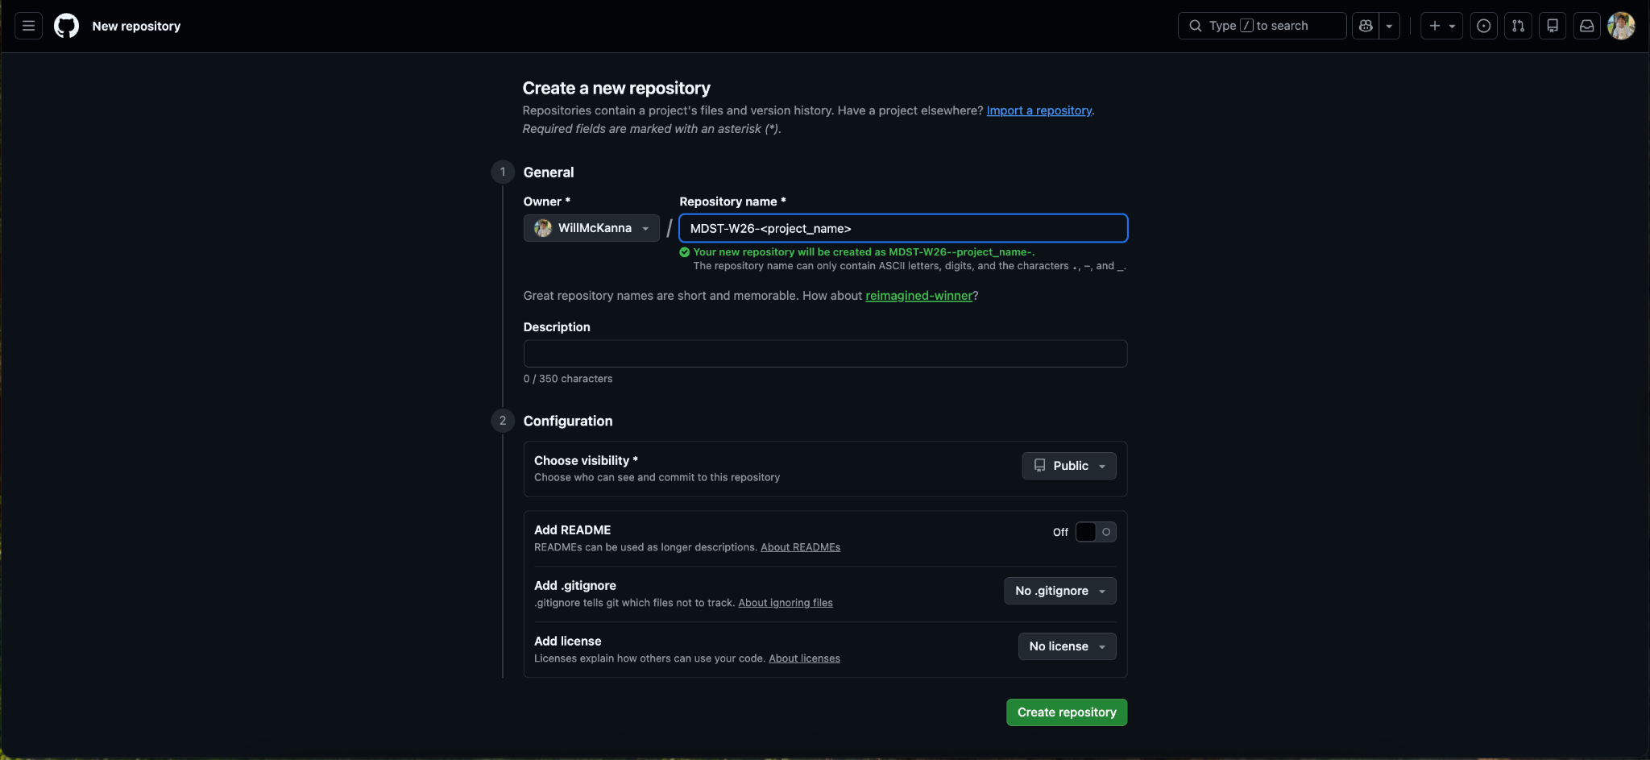
How to Create a GitHub Repository (yay for version control!)
2. Name your repository something memorable, then click “Create Repository”

Slide 14
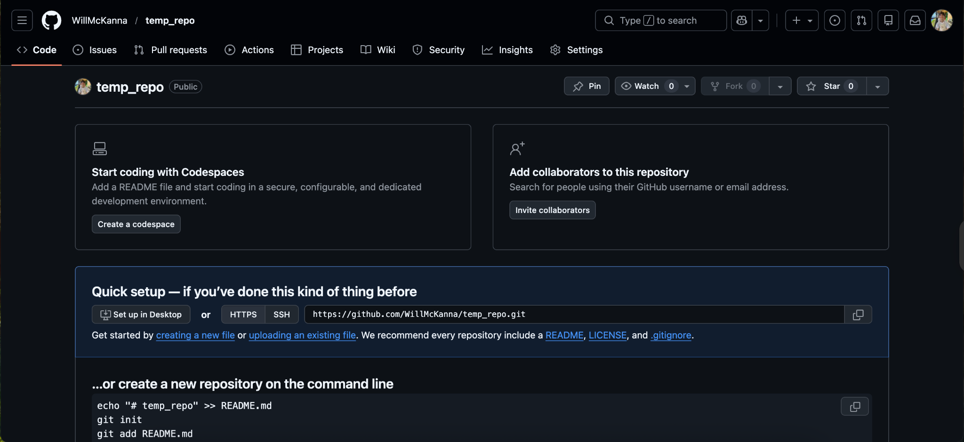
How to Create a GitHub Repository (yay for version control!)
3. Then, populate your repo either with your files, OR click “creating a new file”

Slide 15
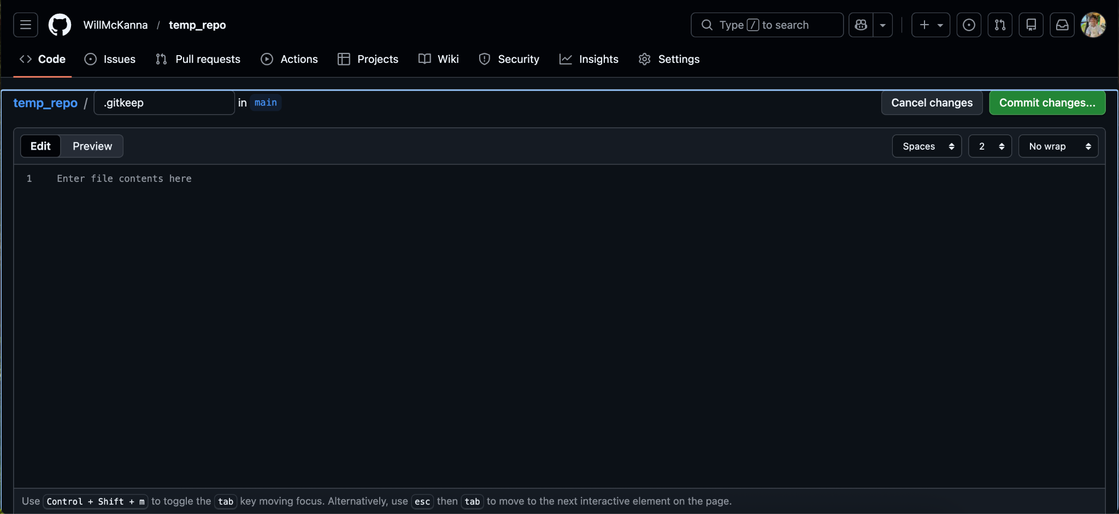
How to Create a GitHub Repository (yay for version control!)
3(b). If you click “create a new file,” entitle it “.gitkeep” and click “Commit changes”

Slide 16
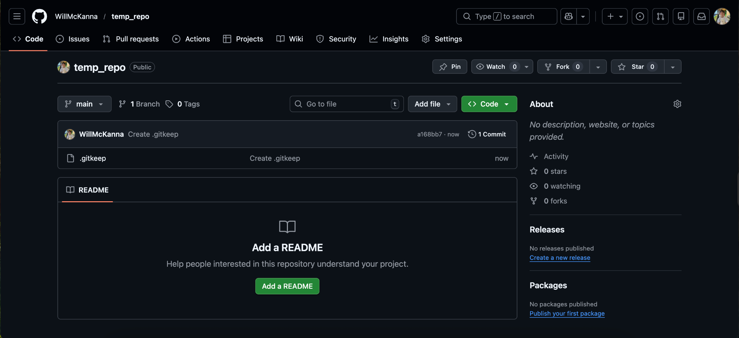
How to Create a GitHub Repository (yay for version control!)
4. Your repo is made! Continue adding to it by clicking the “Add file” dropdown menu

Slide 17
04
References
Here are a handful of useful guides to high-utility functions, Git demos, and Colab explanations!

Slide 18
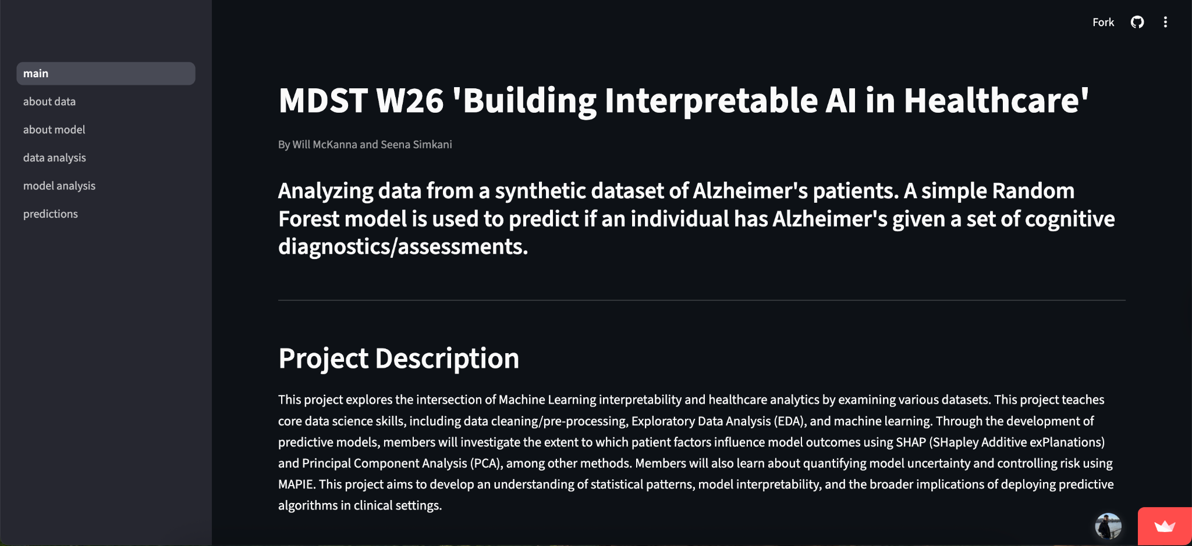
Our Demo! (for reference)
Link: https://mdst-ai-in-healthcare.streamlit.app/

Slide 19





Project Timeline
Week 1 (01/25): Icebreaker/EDA intro, choosing a good dataset
Week 5 (02/22): Conformal Predictions, Risk Control, and Multi-Class Calibration
Week 2 (02/01): Data Visualization, Further EDA
NO MEETING 03/01 OR 03/08 – SPRING BREAK
Week 6 (03/15): SHAP Values and Feature Importance Interpretation
Week 3 (02/08): Feature Engineering and Intro to Machine Learning
Week 7 (03/22): Intro to Streamlit and Project Work Time
Week 4 (02/15): Machine Learning and Model Optimization
Weeks 8 + 9 (03/29 + 04/05): Final Project work time + Data Science Night prep!

Slide 20
Important Functions to Know (pt. 1)
Syntax | Description
import pandas as pd | Import the pandas library, using the alias pd for convenience
import numpy as np | Import the NumPy library, using alias np for numerical operations
import seaborn as sns | Import Seaborn for statistical data visualization
df = pd.read_csv(‘file.csv’) | Load a CSV file into a pandas DataFrame for data manipulation
df.head() | Returns the first 5 rows of the DataFrame, useful for quickly inspecting data
df.info() | Provides a concise summary of the DataFrame, including data types and non-null values

Slide 21
Important Functions to Know (pt. 2)
Syntax | Description
df.describe() | Generates descriptive statistics of numerical columns (mean, median, quartiles, etc.)
df[‘column_name’] | Access a specific column in the DataFrame, works like a key in a dictionary
df.drop(columns=[‘col’...]) | Drops specified columns from the DataFrame,use inplace=True to modify the original DataFrame
df.index | Returns the index labels of the DataFrame
df.isnull() | returns a DataFrame of boolean values, where each entry indicates whether the corresponding value in df is NaN (missing)

Slide 22
Important Functions to Know (pt. 3)
Syntax | Description
df[‘column’].value_counts() | Returns the count of unique values in a specific column
df[‘column’].mean() | Returns the mean value of a numerical column
df.corr() | Computes correlation for numerical columns to understand relationships
df.columns | Lists all column names in the DataFrame, useful for renaming or viewing dataset structure
df.shape | Returns # of rows and columns

Slide 23
Important Functions to Know (pt. 4)
Syntax | Description
df.rename(columns={'old': 'new'}, inplace=True) | Renames specific columns to new names
df.groupby(‘category’)[‘value’] | Groups the DataFrame using a specified column to perform aggregate functions (e.g., .sum(), .mean())
df[‘new_column’] = df[‘column’].apply(function) | Applies a function to each element or column/row
df.shape | Returns a tuple representing the dimensions (rows, columns) of the DataFrame
df.dropna() | Removes rows or columns containing missing values

Slide 24
Important Functions to Know (pt. 5)
Syntax | Description
df.to_numpy() | Converts Pandas DataFrame into a NumPy array
np.shape | Returns a tuple representing the dimensions (rows, columns) of the array (similar to df.shape)
np.reshape() | Reshapes an original numpy array to the specified dimensions (rows, columns)
np.array() | Creates an N-dimensional array (ndarray) which is more memory efficient than standard python lists
np.unique() | Returns the unique elements in a NumPy array (also returns the counts of each element given the keyword argument, return_counts=True)

Slide 25
Important Functions to Know (pt. 6)
Syntax | Description
pd.cut() | Turns continuous numerical data into categorical data
pd.get_dummies(drop_first = True) | Dummy encodes categorical data (used with drop_first argument)
OrdinalEncoder() | Function for encoding categorical information that has an order
train_test_split(X, y, test_size=0.2, random_state=42) | Splits data into a training set and a testing set. The test set size can be changed
LinearRegression() | Used for initializing a linear regression model
LogisticRegression() | Used for initializing a logistic regression model

Slide 26
Important Functions to Know (pt. 7)
Syntax | Description
StandardScaler() | Turns continuous numerical data into categorical data
model.fit(X_train, y_train) | Fits a model to the training data
model.predict(X_test) | Uses the test data to make predictions
.coef_ | Attribute for getting the models coefficients (for linear and logistic regression)
mean_squared_error() | Calculates the average squared distance between the predicted and actual data points
mean_absolute _error() | Calculates the average distance between the predicted and actual values

Slide 27
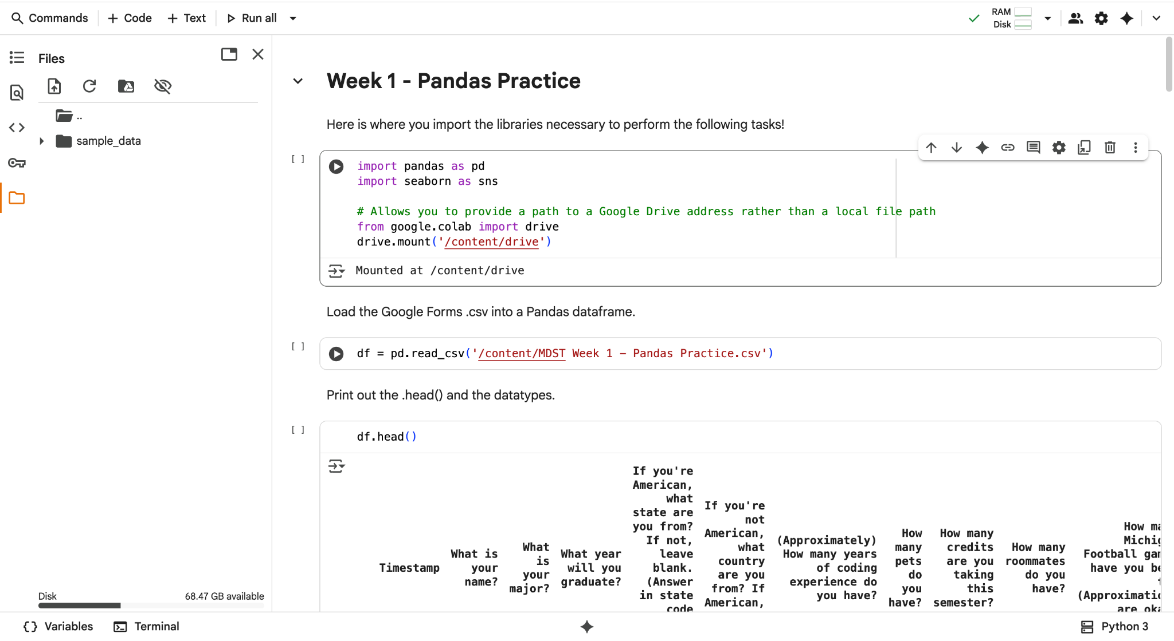
How to Upload Files into Colab
Click on the folder in the sidebar

Slide 28
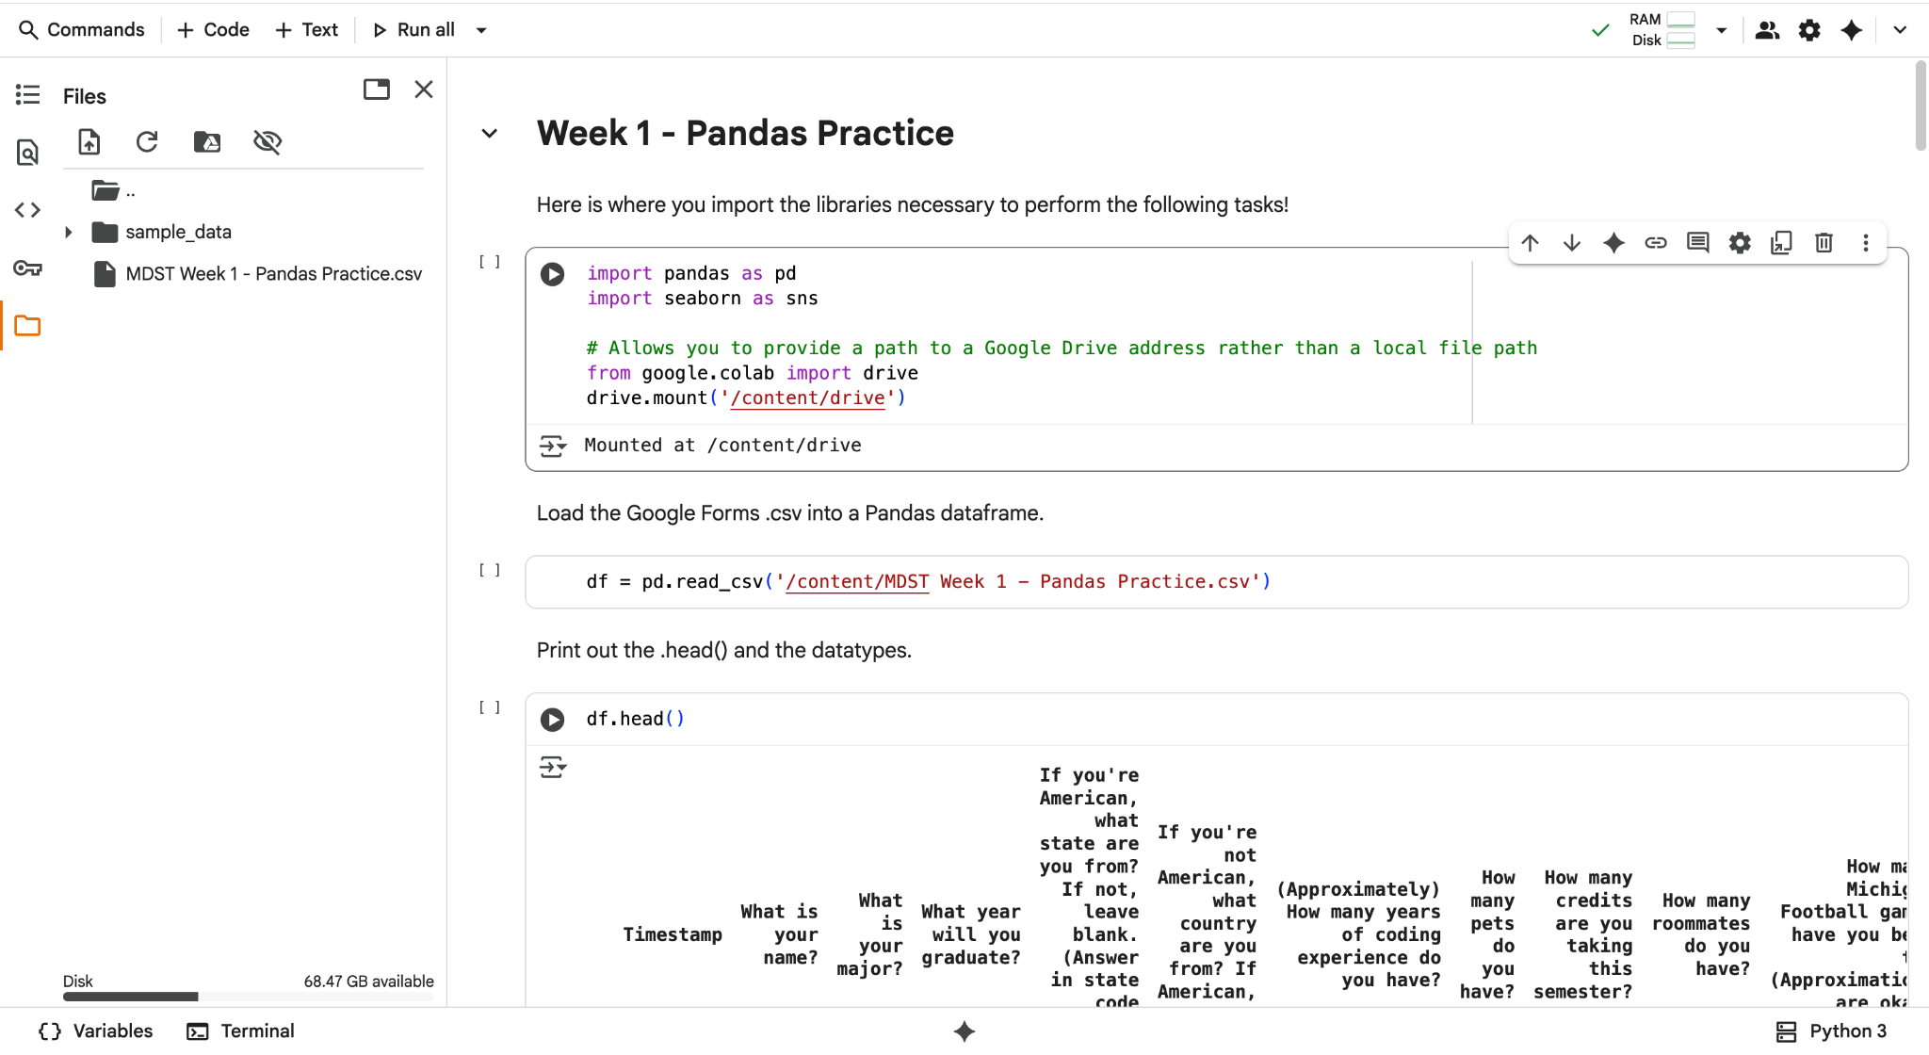
How to Upload Files into Colab
Click the upload button and select the file you want to upload

Slide 29
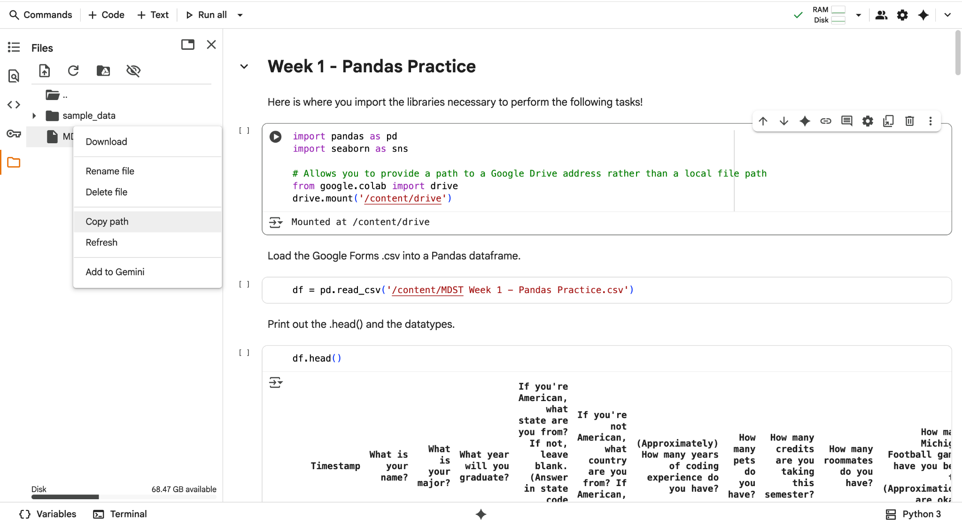
How to Upload Files into Colab
Click the three dots and copy the path. Put this in your read function

Slide 30
How to Mount Your Google Drive
from google.colab import drive
drive.mount('/content/drive')
pd.read_csv(‘/content/drive/MyDrive/[FILE NAME]’)
**NOTE: If you saved your dataset in a folder (not just loose in your MyDrive folder), you will need to add further code to the file path before the file name in the final line. For example, if I saved my data called “alzheimers.csv” in a folder called “MDST-W26,” my read_csv statement would read:
pd.read_csv(‘/content/drive/MyDrive/MDST-W26/alzheimers.csv’)

